Slide 1

Impact from Day 1
Project Portfolio – Strategic Applications for National Paints Group
Mahmoud Ali

Slide 2

Summary
This portfolio presents 4 real-world projects—each tested in live business contexts and fully adaptable to National Paints Group.
It demonstrates how I can contribute to your market research, channel performance, and product strategy from Day 1.
“I don’t just study the market — I’ve built tools and made decisions that fixed it.”

Slide 3




How This Portfolio Aligns with National Paints Group’s Needs
Market Research
Consumer behaviour analysis, competitor benchmarking, trend scanning
Data Analysis
Dashboards, clustering models, profitability simulators
Field Intelligence
Store visits, retailer interviews, channel bottleneck identification
KPI Development & Performance Insights
Adaptable KPI frameworks (Power BI, Python)
“...monitor marketing trends, perform fieldwork, and deliver research & reporting…”
— From National Paints Group Job Description

Slide 4
Projects
KSA Market Entry Research
SKU Profit & Investment Planning Tool
Regional analysis, market sizing, regulatory insights
Unit economics, financial modeling, pricing simulation
HR KPI Dashboard → SKU Performance Dashboard
Clustering Market Segments
Business intelligence, KPI design, cross-domain logic
Customer segmentation, product mapping, smart insights
Each project has been successfully implemented in real business contexts and is immediately adaptable to your organization.

Slide 5
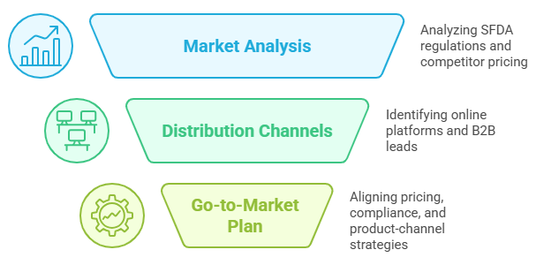
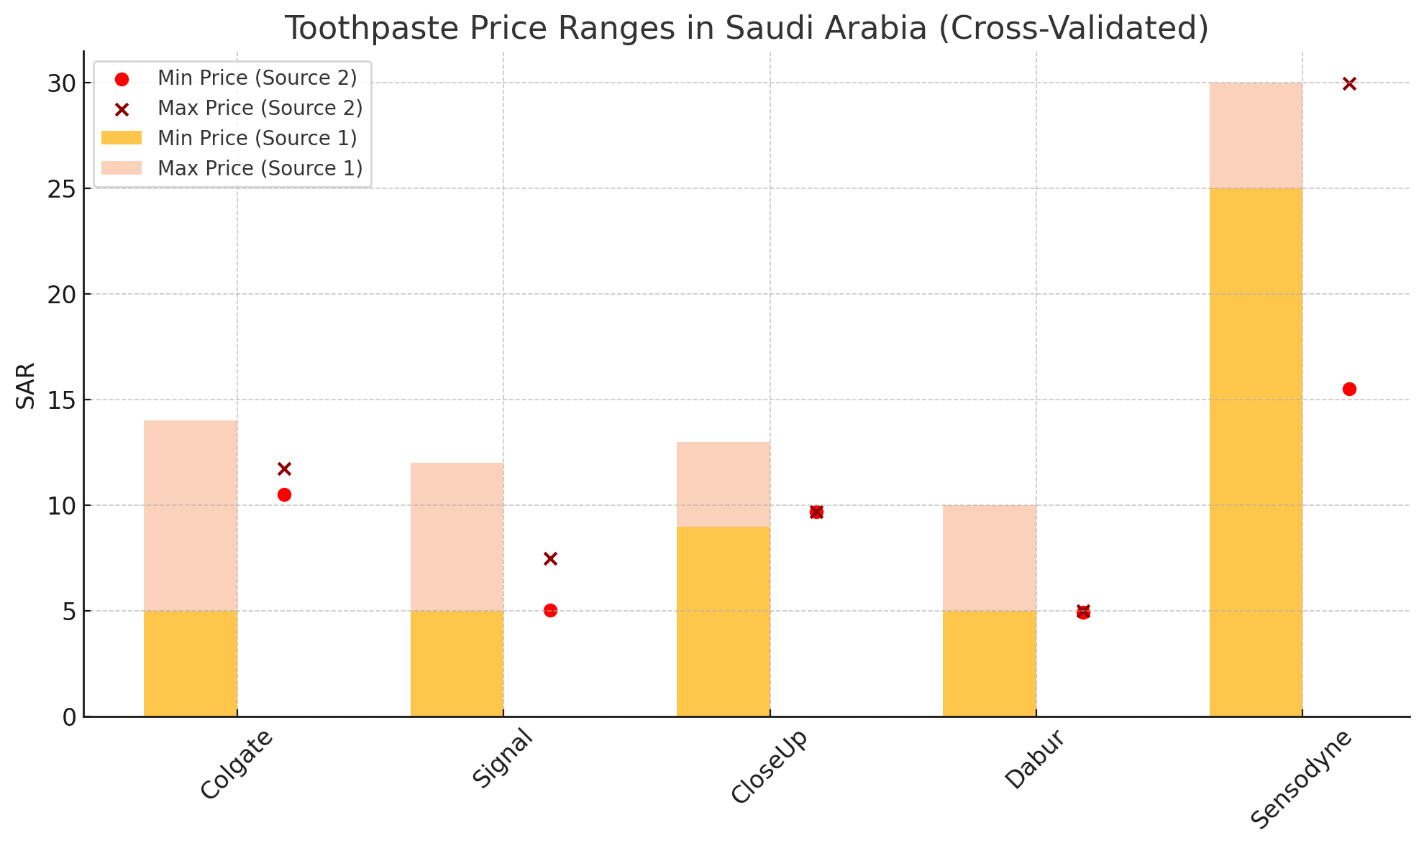
1. KSA Market Entry Research – Oral Care & Functional Products
Tools Used:
Excel · TradeMap · Regulatory Datasets (SFDA) · Competitive Benchmarking
Key Outcomes:
Designed full export readiness roadmap aligned with Saudi regulations
Analyzed pricing bands and competitor positions using live market data
Identified optimal B2B outreach channels and local compliance shortcuts
Relevance to National Paints Group:
Framework can be directly reused for entering Gulf or North African paint markets with new or regionalized lines.

Slide 6
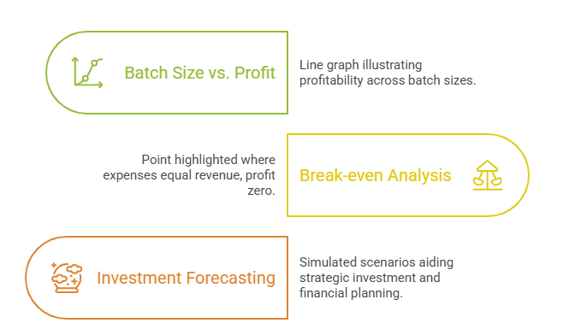
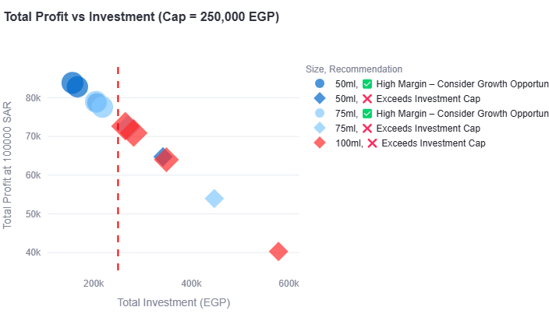
2. SKU Profit & Investment Planning Tool
Tools Used:
Python · Streamlit · Excel · Linear Programming
Key Outcomes:
Built simulator to visualize profit margins by batch size and packaging volume
Enabled breakeven and investment scenario modeling per SKU
Informed strategic batch planning for initial FMCG production cycles
Relevance to National Paints Group:
Can be applied to model paint unit costs, format profitability, or investment logic for seasonal campaigns.

Slide 7
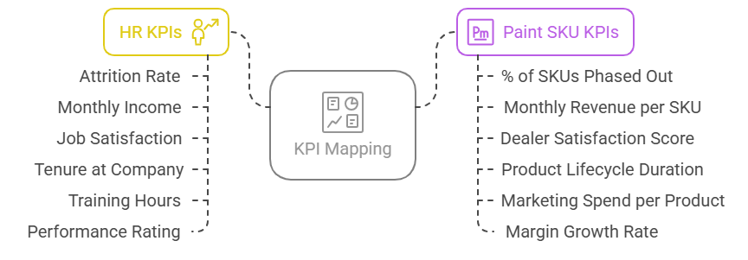
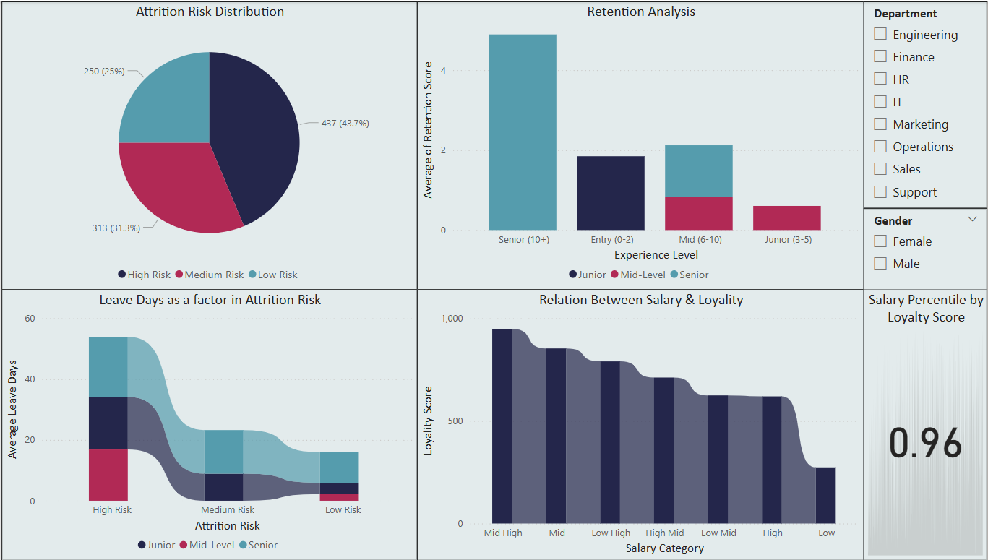
3. KPI Dashboard → SKU Performance Dashboard
Tools Used:
Power BI · DAX · Power Query
Key Outcomes:
Created interactive KPI dashboard originally for HR analytics
Translated key metrics into SKU-focused insights (e.g., attrition = SKU phase-out)
Enabled dynamic filtering by performance, geography, or lifecycle
Relevance to National Paints Group:
A ready template to monitor SKU, store, or sales team performance with real-time dashboards.

Slide 8
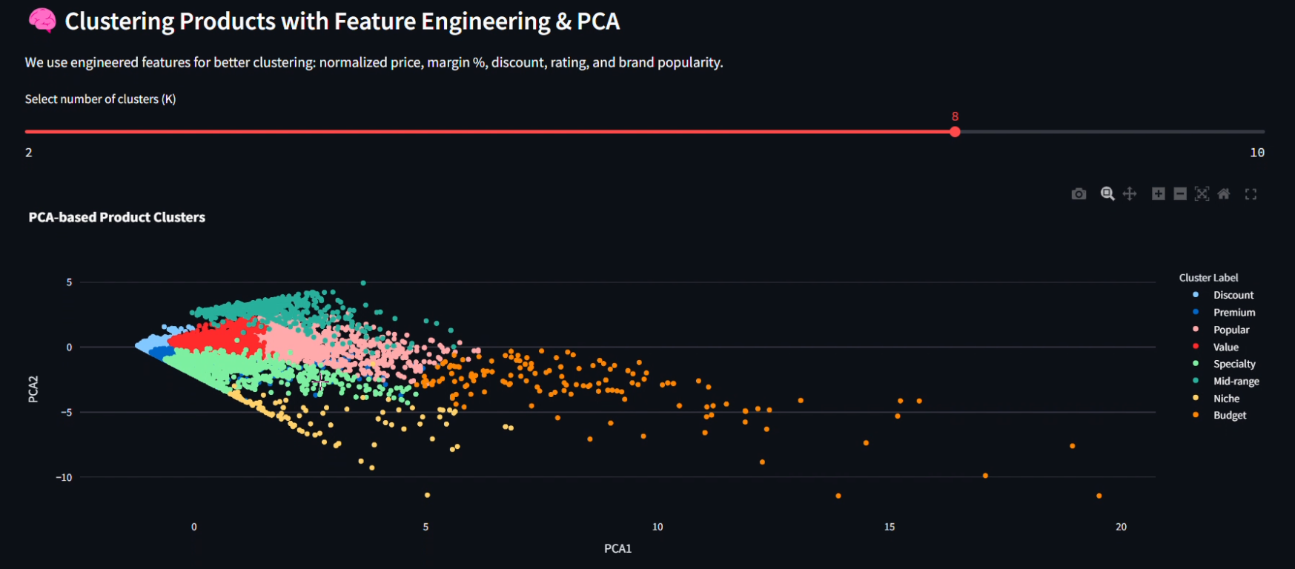
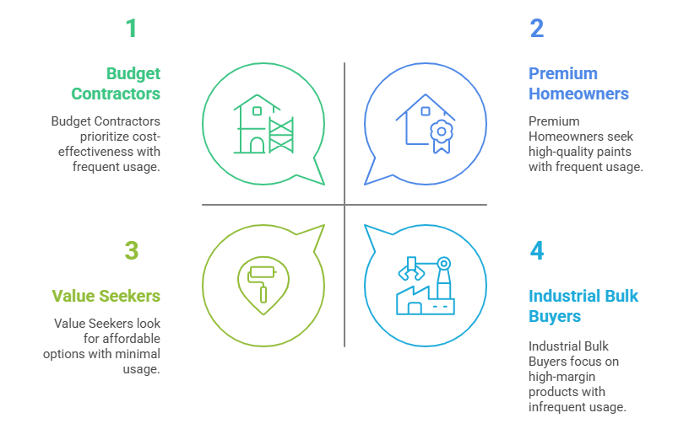
4. Clustering Market Segments
Tools Used:
Python · TF-IDF · KMeans · PCA · Plotly · LSA
Key Outcomes:
Used clustering to segment products by margin, price sensitivity, and behavior
Applied NLP to group products based on feature-rich descriptions
Delivered dashboard-ready insights to tailor marketing and pricing strategy
Relevance to National Paints Group:
Perfect fit to cluster decorative vs. industrial users, price bands, or promotional sensitivity across paint SKUs.

Slide 9
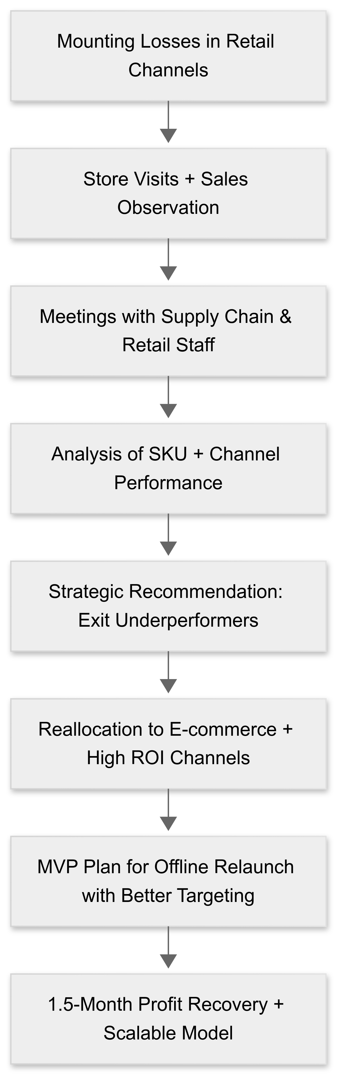
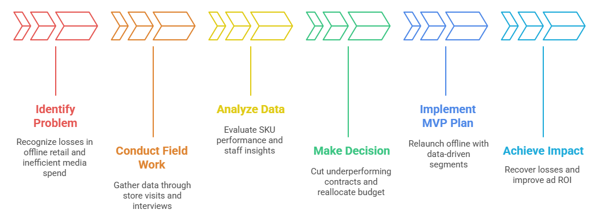
Channel Turnaround Strategy- From Field Research to Profit Recovery
( Recent Success Story )
Flowchart with Mermaid

Slide 10
THANK YOU
This Is Just the Start.
“This portfolio reflects what I can contribute today — but the real value lies in what we can build next.”
From consumer research to performance dashboards, from product analysis to market expansion — I’m ready to support National Paints Group across implementation, field operations, and regional strategy.
Mahmoud Ali

